Slide 1
Network Address Translation
Ilian Trifonov

Slide 2
Network Address Translation
Network address translation (NAT) is a method of remapping one IP address space into another by modifying network address information in Internet Protocol (IP) datagram packet headers while they are in transit across a traffic routing device.
The technique was originally used for ease of rerouting traffic in IP networks without readdressing every host.
It has become a popular and essential tool in conserving global address space allocations in face of IPv4 address exhaustion by sharing one Internet-routable IP address of a NAT gateway for an entire private network.

Slide 3
Why we need NAT
IPv4 does not have enough IP addresses (it has around 4 billion only or 32 bits) to address all devices connected to the internet.
Network Address Translation allows us to connect multiple devices to one public IP address, in doing so limiting the amount of IP addresses needed.

Slide 4
How Network Address Translation Works
It uses port numbers to artificially increase the amount of devices that can be connected
All network connected applications are assigned port numbers, so they can receive response messages from the internet
There are 16 bits used for possible port numbers (from 0 to 65535)
Most devices do not use more than a few hundred port numbers at any one time, so this allows us to use port numbers to artificially increase our address space

Slide 5
How Network Address Translation Works
Network devices take the private IP address and port number for the application, and write it in a table
Then they write an “outward facing” IP address, that is the same for multiple, or all, devices connected to the Network Device, and write a new port number
The “outward facing” IP address gets mapped to the private IP address and the port number of application when a response is returned from the internet

Slide 6
Network Address Translation Example
Application | Private IP Address:: Port | Outward IP Address:: Port
Chrome on 192.168.2.30 | 192.168.2.33::44323 | 10.2.3.25::995
Chrome on 192.168.2.37 | 192.168.2.37::14432 | 10.2.3.25::996
Skype on 192.168.2.111 | 192.168.2.37::4568 | 10.2.3.25::997
NAT Forwarding table

Slide 7
How it works
PC
PC
ISP
Internet
Router
Laptop
Phone
IoT device

Slide 8
How it works
Private Address Space
PC
192.168.2.30
PC
192.168.2.37
ISP
Internet
Router
Laptop
192.168.2.87
Phone
192.168.2.111
IoT device
192.168.2.11

Slide 9
How it works
Private Address Space
Private Address Space
Inside the ISPs network
PC
192.168.2.30
PC
192.168.2.37
ISP
Internet
Router
10.2.3.25
Laptop
192.168.2.87
Phone
192.168.2.111
IoT device
192.168.2.11

Slide 10
How it works
Private Address Space
Private Address Space
Inside the ISPs network
Public IP Address Space
PC
192.168.2.30
PC
192.168.2.37
ISP
Internet
Router
213.130.75.65
Laptop
10.2.3.25
192.168.2.87
Phone
192.168.2.111
IoT device
192.168.2.11

Slide 11
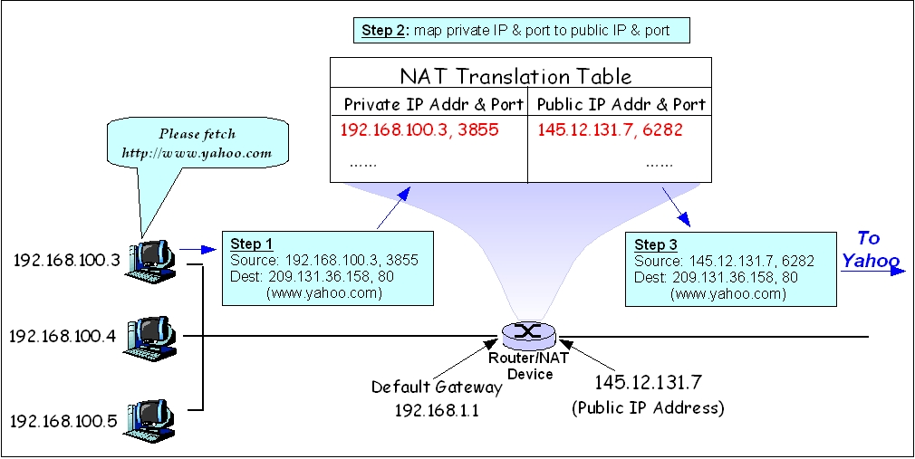
NAT Router diagram

Slide 12
IPv6
No longer needs NAT
Most consumer devices currently in use support IPv6
Very slow to get implemented, mostly due to ISPs

Slide 13
Network Address Translation Advantages
Public IP Address Sharing - Solves IPv4 address space shortages, and saves ISPs money, as they can buy less IP addresses
Easier Expansion - Since local network devices are privately addressed and a public IP address isn't needed for each one, it is easy to add new clients to the local network.
Greater Local Control - Administrators get all the benefits of control that come with a private network, but can still connect to the Internet.
Greater Flexibility In ISP Service - Changing the organization's Internet Service Provider (ISP) is easier because only the public addresses change. It isn't necessary to renumber all the client machines on the network.

Slide 14
Network Address Translation Advantages
Increased Security - The NAT translation represents a level of indirection. Thus, it automatically creates a type of firewall between the organization's network and the public Internet. It is more difficult for any client devices to be accessed directly by someone malicious because the clients don't have publicly-known IP addresses.

Slide 15
Network Address Translation Disadvantages
Complexity - NAT represents one more complexity in setting up and managing the network. It also makes troubleshooting more confusing due to address substitutions.
Problems Due to Lack of Public Addresses - Certain functions won't work properly due to lack of a “real” IP address in the client host machines. This is related to protocols that use IP addresses directly, like VoIP. For such application, the network devices have to know about each application, so they can translate addresses inside custom protocols as well
Problems With Security Protocols - Protocols like IPSec are designed to detect modifications to headers and commonly balk at the changes that NAT makes, since they cannot differentiate those changes from malicious datagram “hacking”. It is still possible to combine NAT and IPSec, but this becomes more complicated.

Slide 16
Network Address Translation Disadvantages
Poor Support for Client Access - The lack of a public IP address for each client is a double-edged sword; it protects against hackers trying to access a host but also makes it difficult for legitimate access to clients on the local network. “Peer-to-peer” applications are harder to set up, and something like an organizational web site (accessed from the Internet as a whole) usually needs to be set up without NAT.
Performance Reduction - Each time a datagram transitions between the private network and the Internet, an address translation is required. In addition, other work must be done as well, such as recalculating header checksums. Each individual translation takes little effort but when you add it up, you are giving up some performance.

Slide 17
Network Address Translation Disadvantages
Single point of failure – Only 1 router knows about the NAT forwarding table, and can make the translation. You have to have backups, and share them with other network devices for all the forwarding tables in case of any failure in a single network device.

Slide 18
Questions?

